Slide 1
Customer Support Chatbot for Twitter
Omar Walid Hamed
49-7769

Slide 2
Table of contents
01
02
03
04
05
06
Introduction
Dataset
M2 Network
M3 Network
Results
Conclusion

Slide 3
01
Introduction

Slide 4
02
Dataset

Slide 5
Dataset
3M Tweets, Spanned over 787346 conversations
113 words per tweet
Only 3 messages in the conversations!!!
Most answers are in the form “Send us a DM”, “Go to this link”, etc..
Dataset is too large!!

Slide 6
03
M2 Model

Slide 7
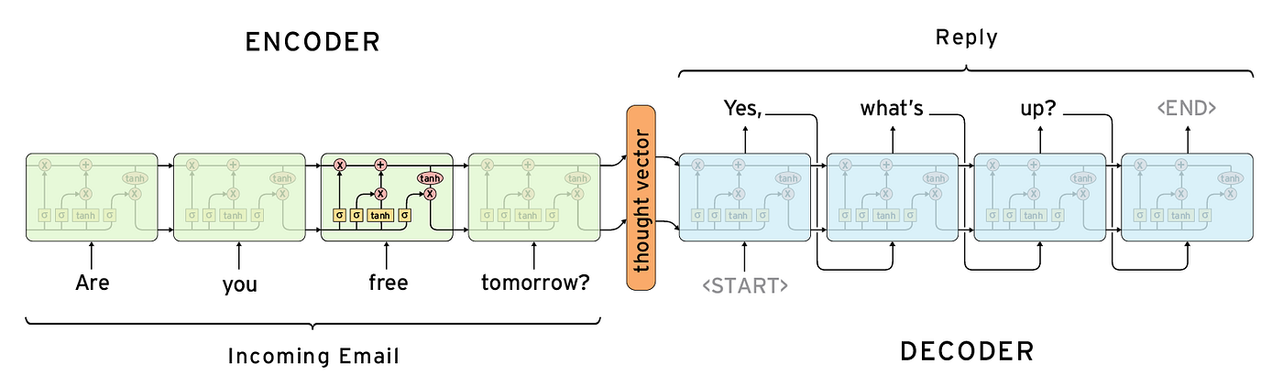
Seq2Seq Models

Slide 8
Word Embeddings
Generated using skip-gram algorithm (context window = 5)
21,716 tokens
Embedding dimensions = 100

Slide 9
Model Architecture
Encoder-Decoder Architecture
2-Layer LSTM in both encoder and decoder with size of 30 neurons
Encoder processes question to get thought vector
Thought vector passed to the decoder to generate the answer
Special tokens are used to indicate questions and ansers

Slide 10
Training
Sequence length = 50
Cross-entropy loss function + Perplexity
Adam Optimizer (lr = 0.001)
15 epochs
80/20 split

Slide 11
03
M3 Model

Slide 12
Pre-trained Model
Many options to choose from (BERT, GPT-2, Llama, Albert, T5, etc..)
T5 was chosen because
Trained on sequence-to-sequence tasks (encoder-decoder)
Already has a pre-trained LM head
Smaller versions are available

Slide 13
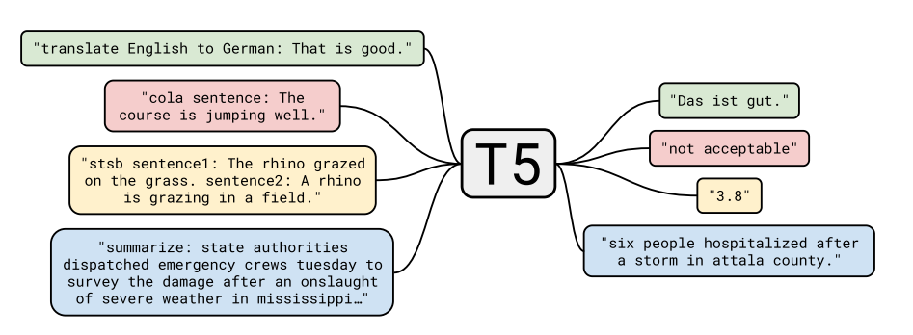
T5 Model

Slide 14
Dataset
Only 30% of the dataset was used (for efficiency)
Sequence length = 64
Answers are prefixed with the company name

Slide 15
Training Method
Encoder layer was frozen
Decoder and LM head were fine-tuned
Trained for 8 epochs
Adam Optimizer (3e-4)
Same loss calculation as custom network

Slide 16
04
Results

Slide 17
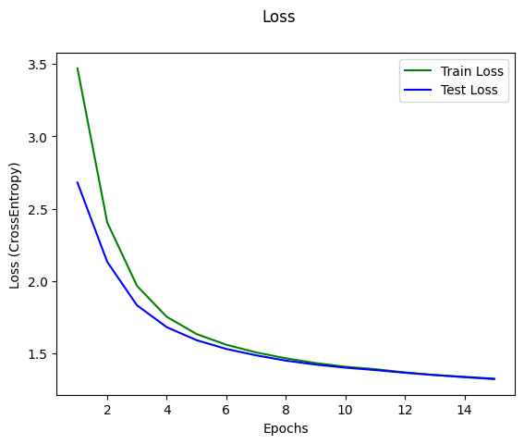
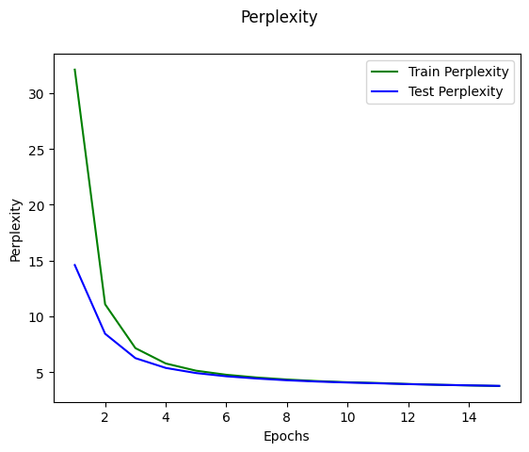
Custom Network

Slide 18
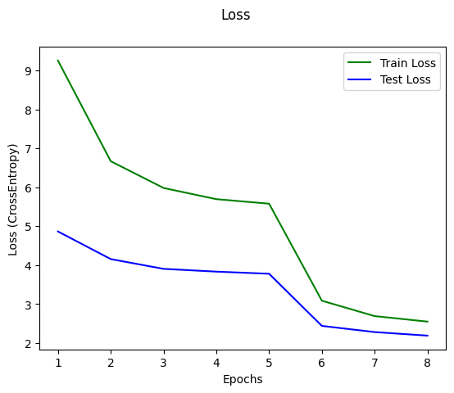
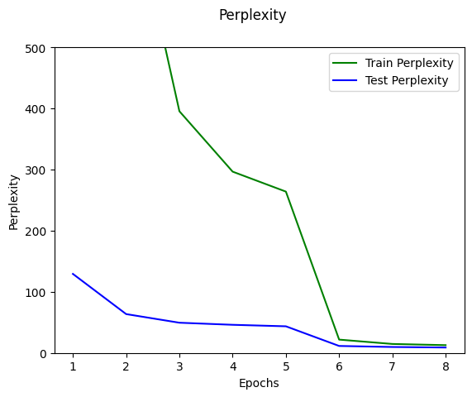
Fine-tuned Model

Slide 19
M2 Sample Conversations

Slide 20
M3 Sample Conversations

Slide 21
06
Conclusion

